Slide 1
FuelMart & Subway Safety Committee Meeting
Wednesday, September 18, 2019
2:00 PM
Corporate Office Conference Room and GoTo Meeting Web Conference

Slide 2
August 2019 Review:
Safety Topic – School Zone Safety
No open safety concerns or suggestions

Slide 3
Safety Dept. Personnel:
Lisa Hamilton (lisa@portspetro.com) joined the safety dept. on Monday, Sept. 16, 2019.

Slide 4
FuelMart Insurance Audits:
In 2019 five FuelMart locations have had insurance building audits.
Insurance auditors have been focused on:
Annual fire extinguisher inspections are current
If equipped, annual fire suppression systems (sprinkler & standpipe) inspections are current
If equipped, emergency lighting working properly (illuminates)
Trip hazards such as potholes in parking lot, broken or crumbling sidewalks, uneven floors
Building in good repair - No building material missing such as siding, trim, etc.
Bathrooms properly working, no water leaks, no broken mirrors, etc.

Slide 5
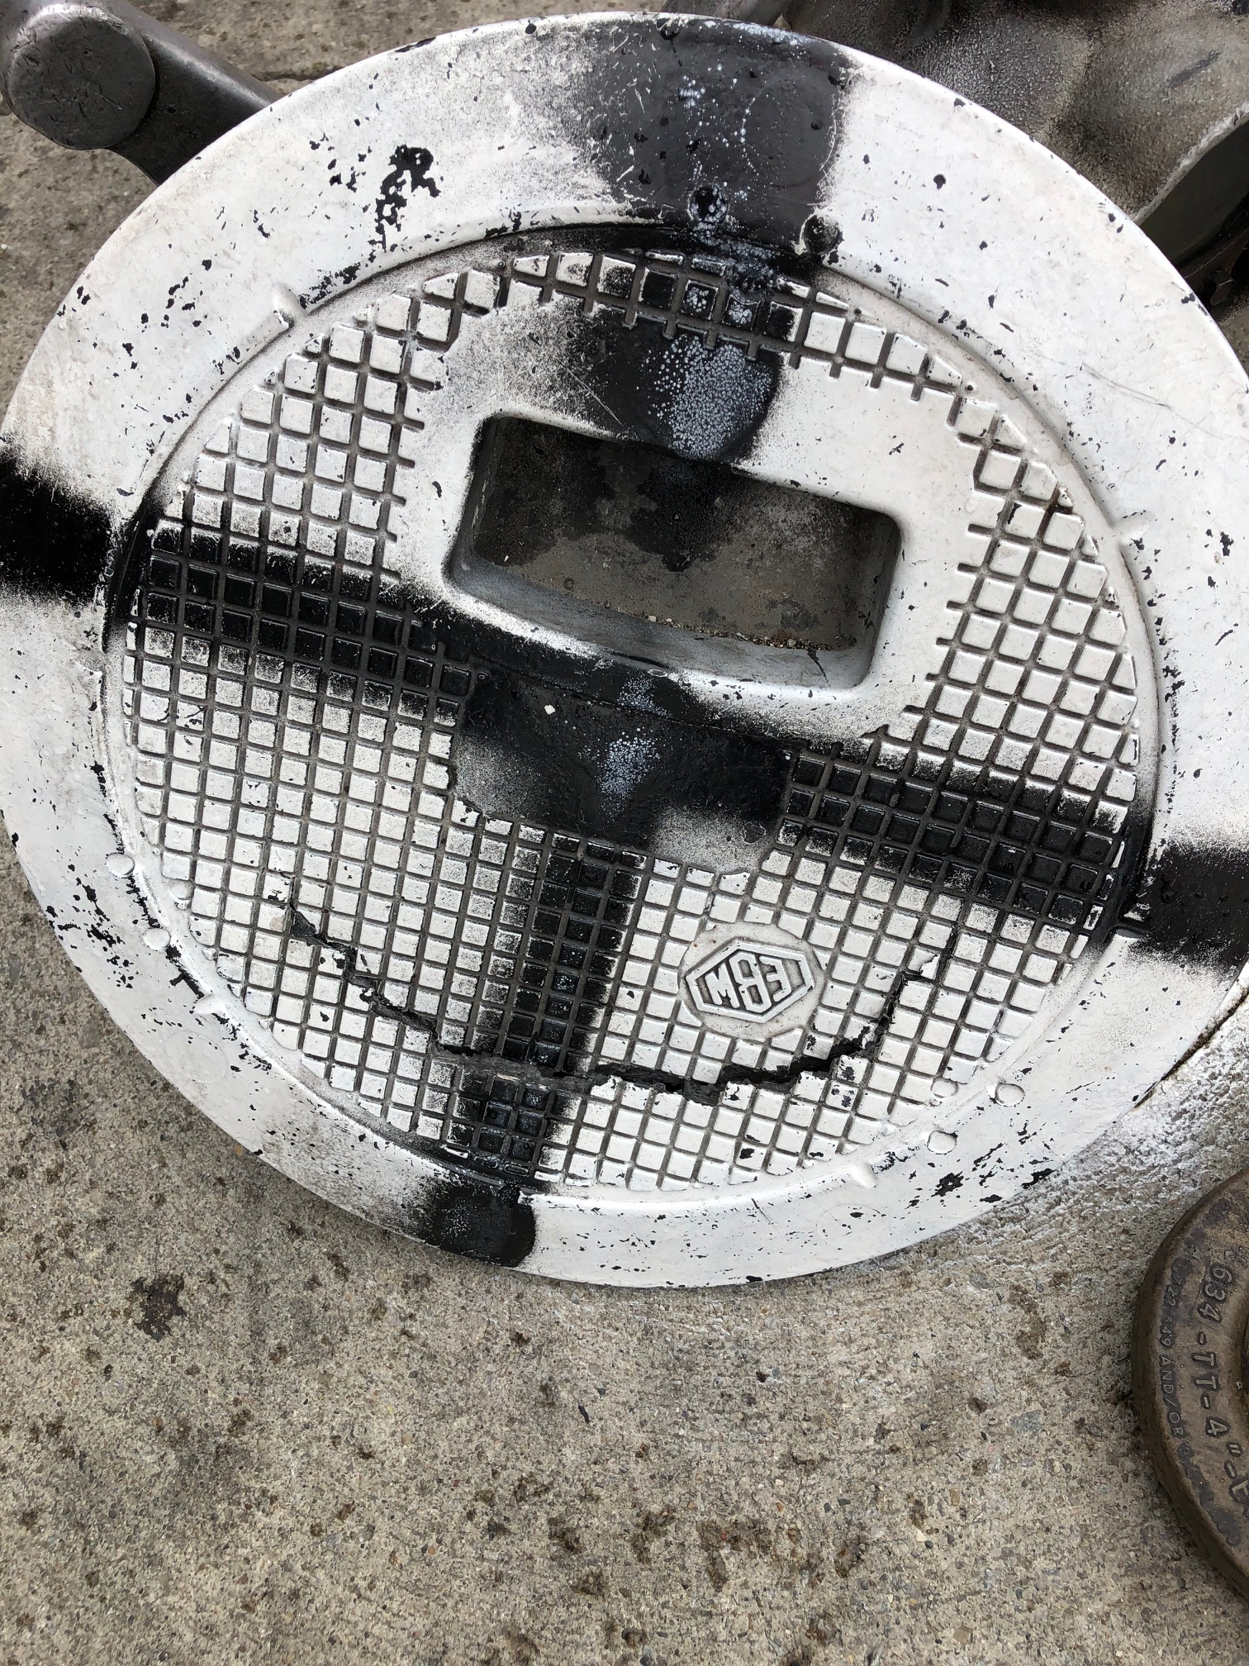
Employee Concerns:
FM 782 on 09/08/19 a fuel delivery driver noticed the tank cover was cracked and reported it.

Slide 6
Incidents and Injuries From 08/21/2019 to 09/16/2019

Slide 7
Employee Injuries:
Previous Injury - 06/24/2019 – Subway employee putting bread on a rack and burnt arm on pan.
08/27/2019 – Subway, employee washing vegetable slicer and it slipped out of the hand and the employee tried to grab it and it lacerated the employees' finger. First aid treatment only.
08/31/2019 – Employee was changing outside garbage. After pulling the bag out of the trash can the employee lost balance and fell. Employee sought medical treatment.

Slide 8
Customer Incidents:
FM 764 - On 08/26/2019 a customer was fueling RV and diesel fuel splashed out from fuel tank. Customer was covered in diesel and the side of the RV was sprayed with fuel.
FM 641 - On 09/03/2019 a customer got out of their vehicle and stepped on the curb. The customer fell back and hit their had on the concrete. FM employee helped the customer and authorities were notified. Customer refused medical treatment.

Slide 9
FM 787 ups trailer spill:
On 09/4/2019 a UPS trailer was leaking an unknown substance near the diesel fuel island. The driver thought it was soap (non-hazmat), but he wasn't 100% confident. Based on the information from the driver that it was soap a FM employee put a finger in the liquid, and was informed by FM manager to remove her hand, to immediately wash hands and informed to never put your hand in a liquid if you are not 100% confident on what the liquid is as it could be toxic, corrosive, etc. The driver's manifest paperwork didn’t spell out the contents in the trailer but used UPS codes. The manifest did indicate some of the products on the trailer were hazmat. UPS could not determine the contents in the trailer and the trailer door remained closed to help as a containment unit.
The local fire dept. and police dept. responded. UPS activated their hazmat emergency response team and arrived on site early afternoon. Once onsite the product was determined to be a Uv Polymer which is used to make the toner ink which is used in copier toner ink cartridges.
Reminder: Haley and the safety dept. is reminding FM employees of the potential injury when making contact with unknown substances and to not touch an unknown substance that is leaking from a customer's vehicle or trailer.

Slide 10
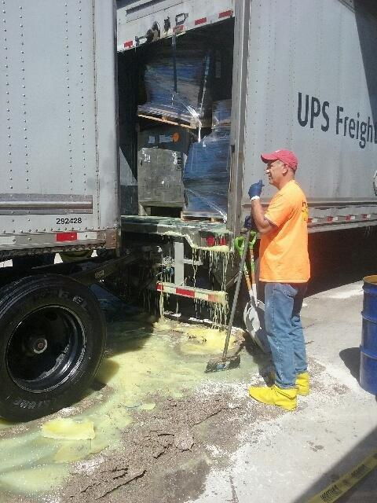
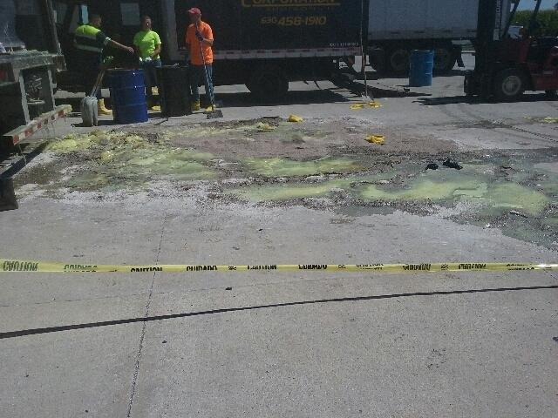
FM 787 ups spill:

Slide 11
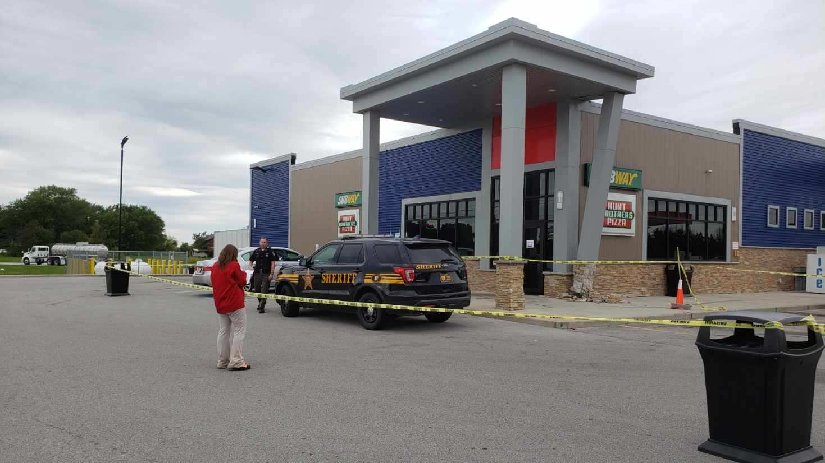
FM 767 property damage:
On 09/06/19 a passenger vehicle drove onto the FM lot and into a parking spot but failed to stop and drove over the building sidewalk curve striking the entrance canopy column and knocking it off it's foundation. Keith M. and Heather M. witnessed it and when Keith went outside the lady was backing up like she was going to drive away so Keith started taking photos of her vehicle and she stopped. The area was cordoned off with caution tape. The Sheriffs responded. The lady told everyone she was leaving, and she thought she had it in reverse, but it was actually in drive and the vehicle struck the building. Per the FM video footage that is not what occurred.

Slide 12
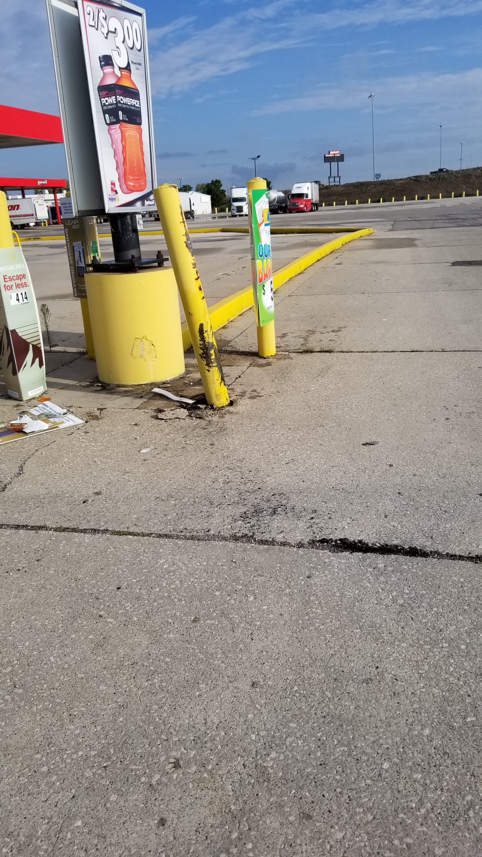
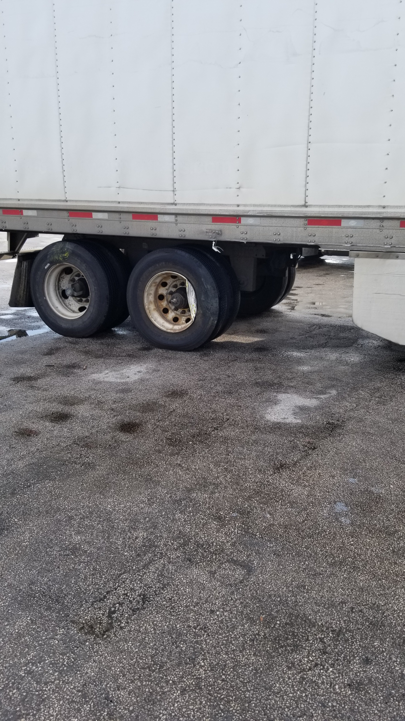
FM 641 property damage:
On 09/12/19 a semi driver struck a bollard with the passenger side trailer tires at the diesel entrance.

Slide 13
FM 767 Customer to Customer vehicle Incident:
On 09/13/19 a customer struck another customer vehicle in the FM parking lot. The at fault customer drove off. The other customer called the Sheriffs and filed a police report.

Slide 14
Date Range: Jan. 01, 2019 – September 16, 2019 Company Total Incidents: 130 (Previously 119) FuelMart & Subway Total Incidents: 68 FuelMart & Subway employee injuries Reported: 13 FuelMart Property Damage and/or Vehicle Incidents: 20 FuelMart Customer Spills: 12 (8 at fuel pumps) FuelMart & Subway Customer injuries reported: 18 Other Incidents: 5

Slide 15
Safety Reminders

Slide 16
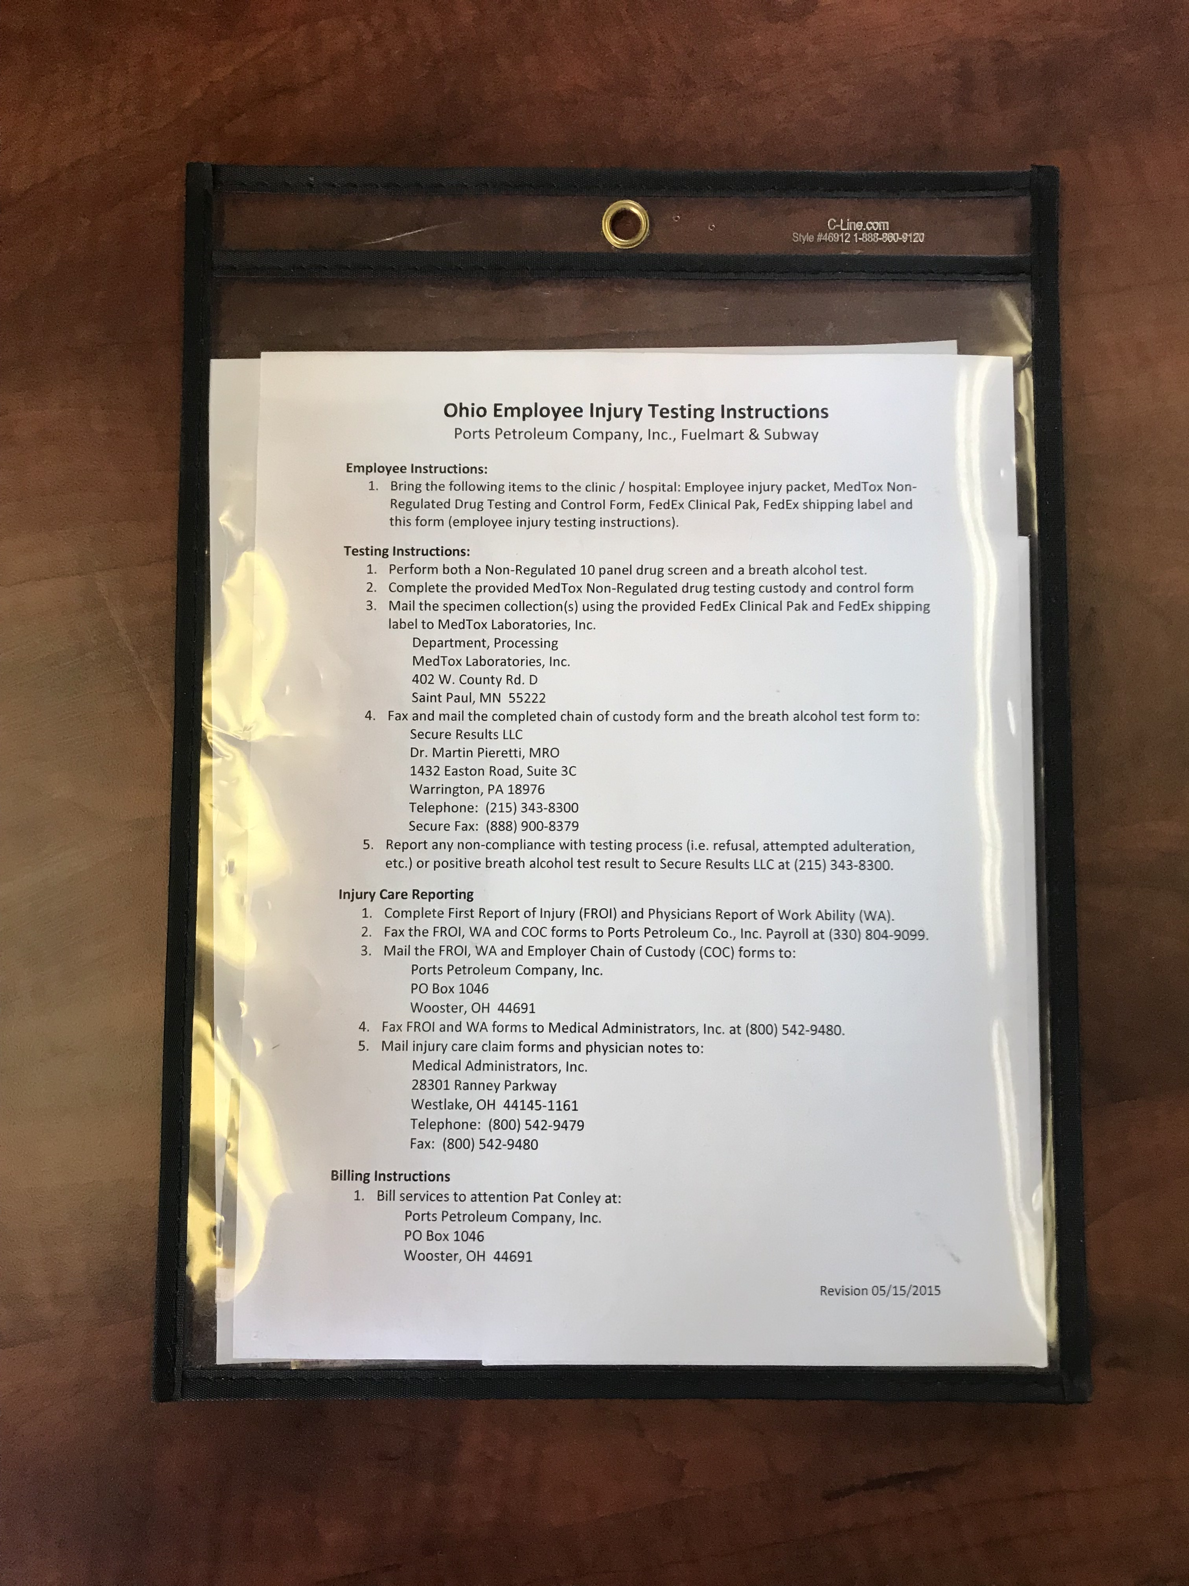
Injury Packets

Slide 17
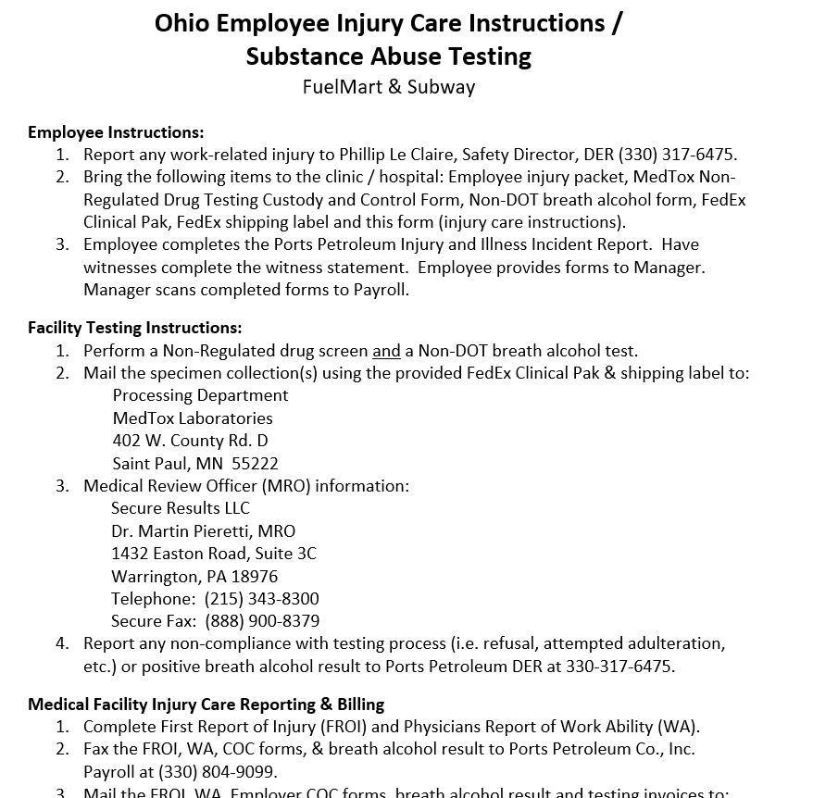
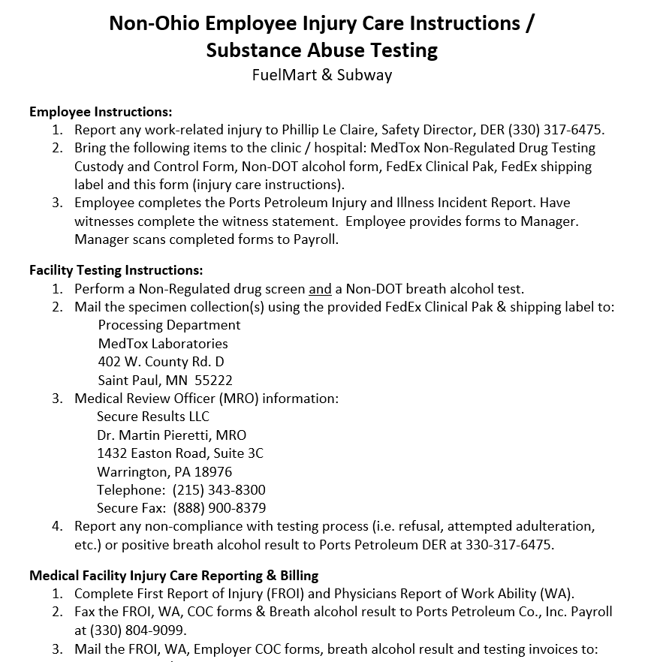
Updated Forms – Injury packets,
revision date 03/19/2019

Slide 18
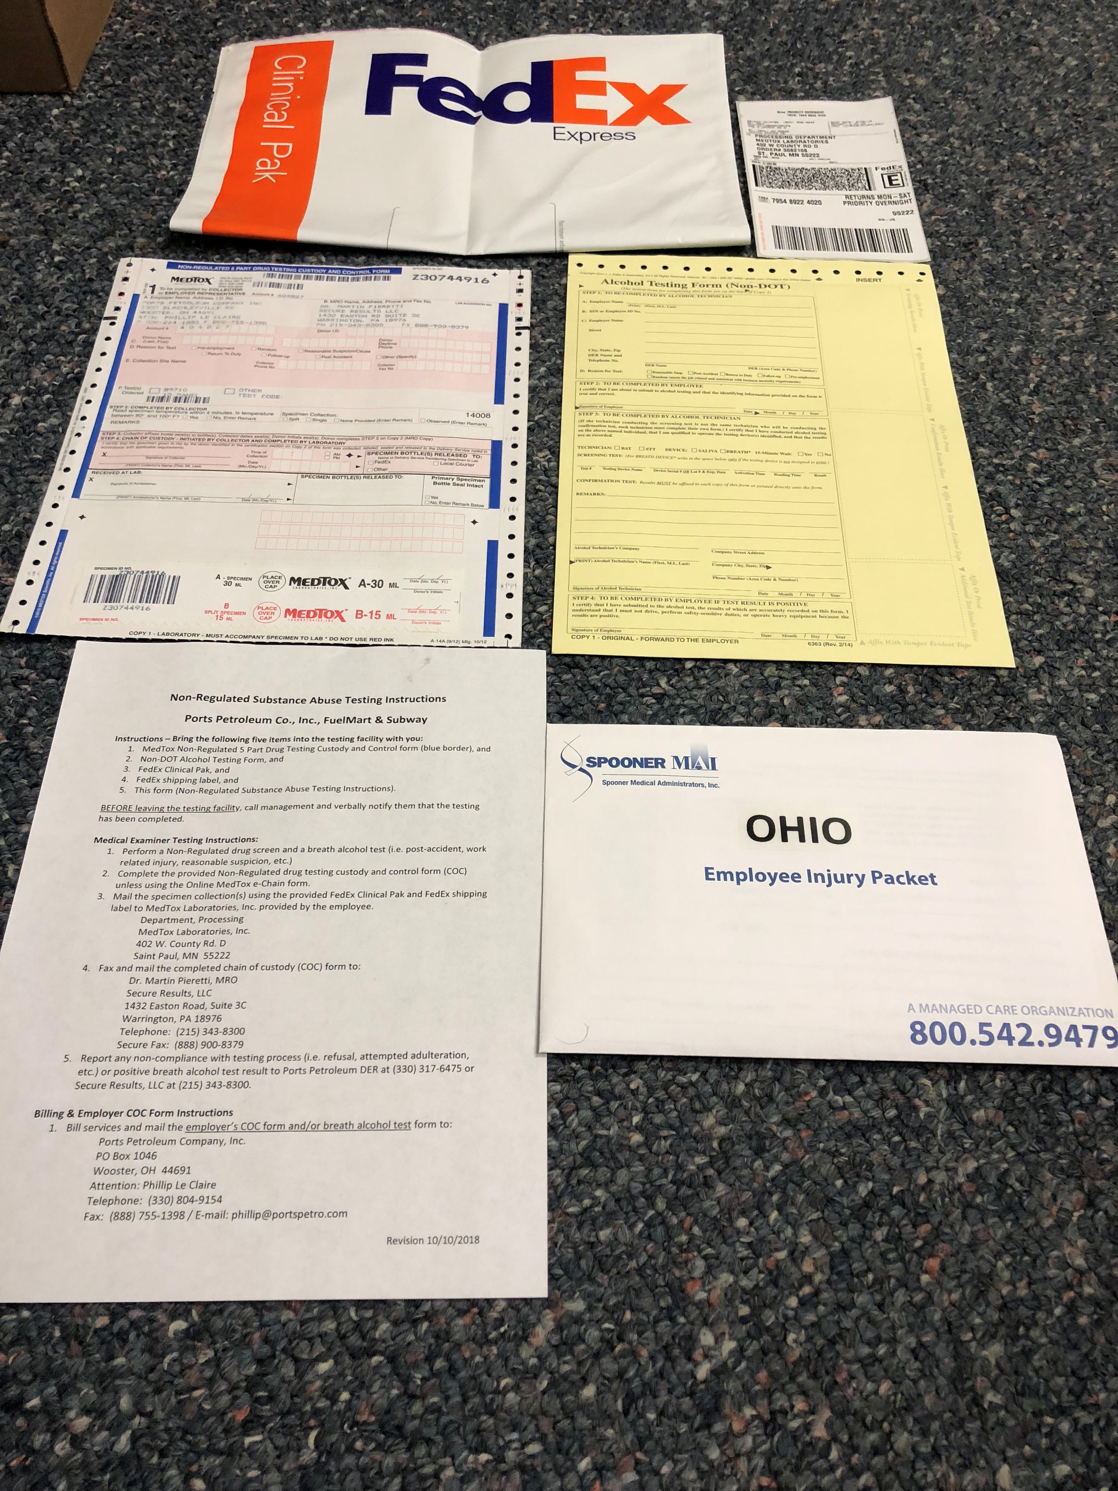
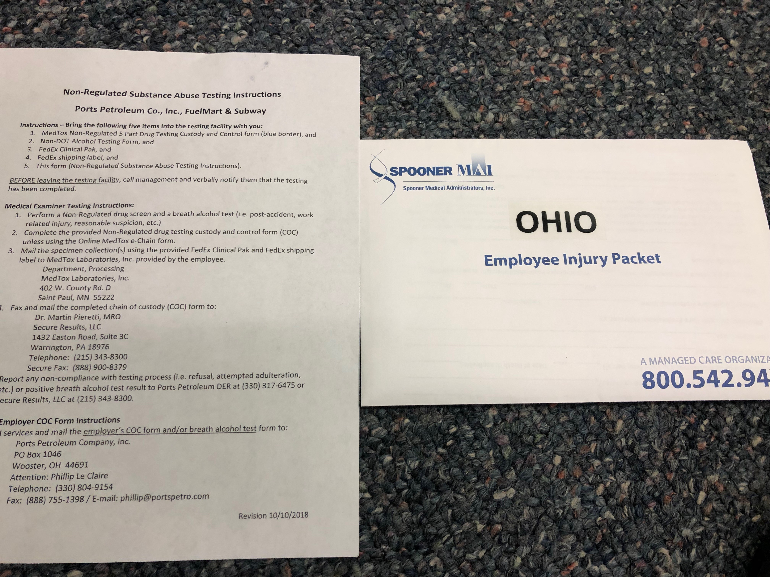
Ohio Injury Packet Contents

Slide 19
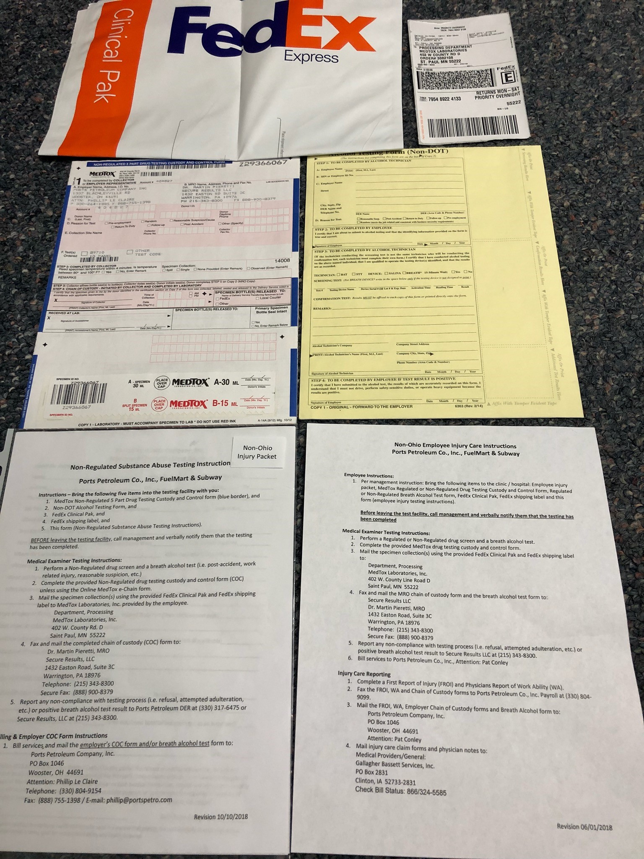
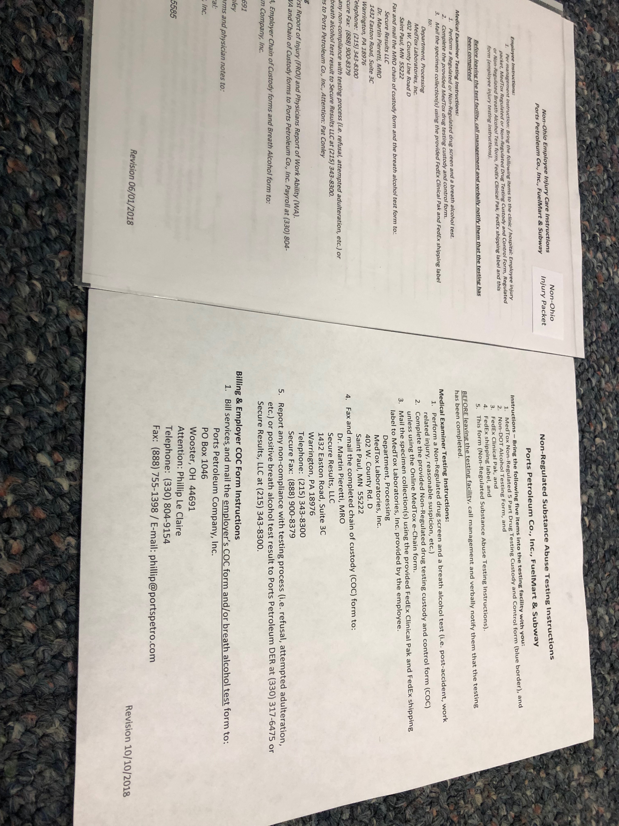
non-Ohio Injury Packet Contents

Slide 20
Injury packets!!
Do all employees know what injury packets are?
Does your facility have five injury packets?
Are they hanging on the wall?
Are they accessible to all employees at all times (day and night – if your 24/7 operation)?
Does each packet contain all the required paperwork?

Slide 21
FM & Subway Incident Guide
Onsite employees will use the following incident procedures. Every incident is unique with its own challenges so procedures will vary including additional procedures provided by the Safety Dept. when the call is made to notify Phillip Le Claire of the incident. Some steps may occur at the same time.
Phone Numbers:
Phillip Le Claire, Safety Director 330-317-6475
Joel Teague, VP of Retail Operations 330-804-9083
Haley Ahrendt, Director of Retail Operations 330-465-6360
Pat Conley, Payroll 330-804-9098
Pre-Planning
Pre-planning items for emergency incidents (vehicle incidents, spills, employee work related injuries, and property damage):
Ensure all employees are knowledgeable. Include incident guide as part of new hire training.
Ensure location has spill pads, yellow caution tape, and oil dry onsite and all employees know where the supplies are located.
Notify the Phillip Le Claire if you need additional spill pads.
Make sure you have reflective safety vests easily available to all employees at all times of the day.

Slide 22
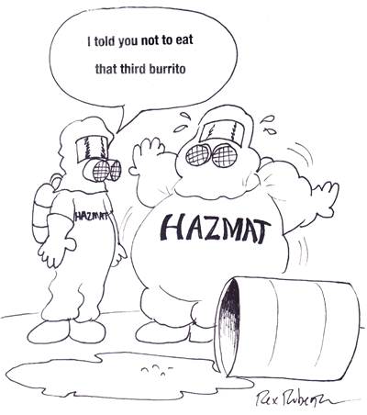
Open Floor Safety Questions / Concerns
Next Safety Committee Meeting is Wednesday, Oct. 16, 2019 at 2:00 PM Eastern

